Slide 1

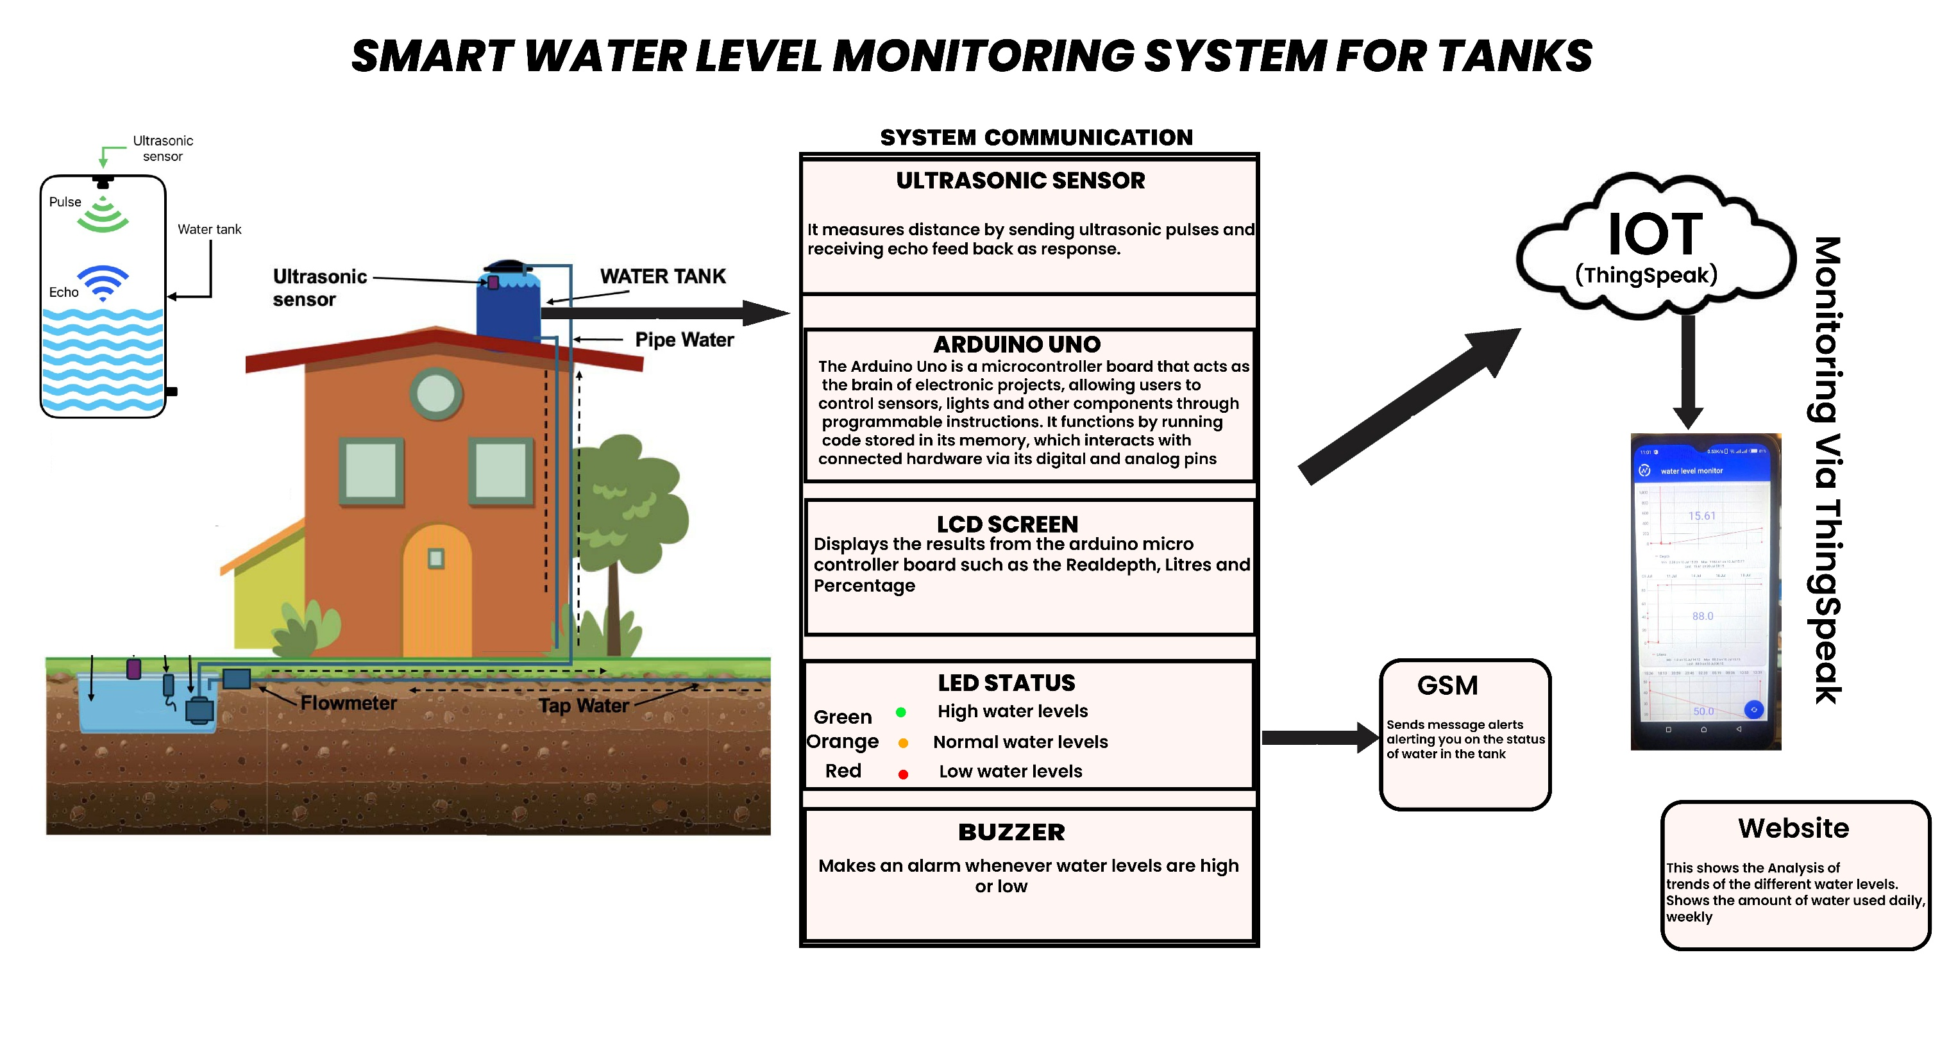
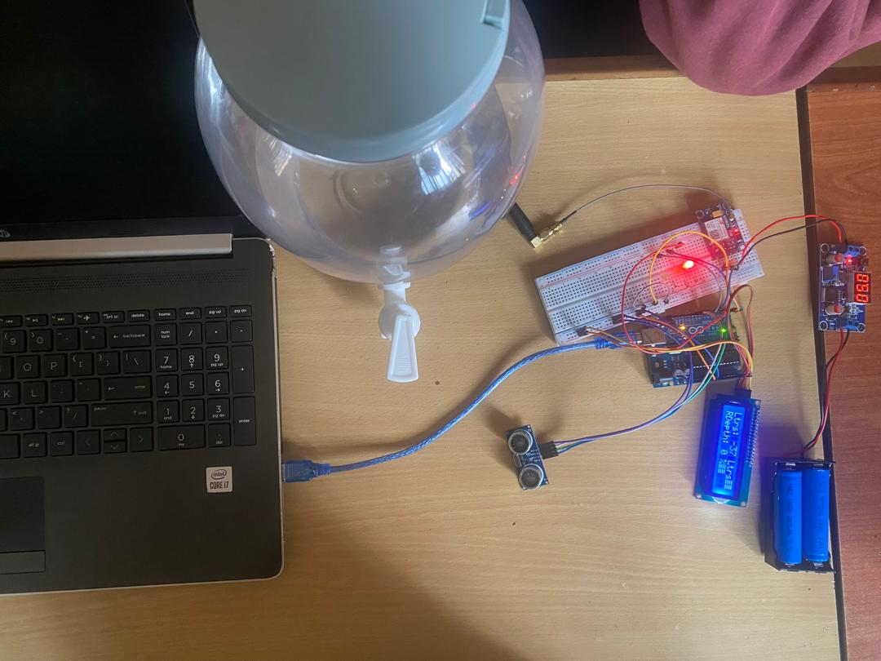
SMART WATER-LEVEL MONITORING SYSTEM FOR TANKS & DRUMS
GROUP 3
Problem
Project Design
Results
In Kampala & Its surrounding urban communities such as Kira, Mukono, and Wakiso, Water storage is commonly done using rooftop or ground-level tanks due to intermittent water supply from NWSC. However, many households lack efficient means of monitoring water levels in these tanks. As a result, tank overflows frequently go unnoticed, leading to water wastage and structural damage, or run dry, leaving residents without water during peak usage times.
Project Objectives
Develop a real-time water-level monitoring system for storage tanks
Alert users of critical water level to prevent overflows or dry tanks.
Improve water management in areas with irregular supply (e.g. Kira)
Reduce manual checks in apartments, schools, and clinics.
Provide simple, accessible user alerts (SMS/display).
Results
Step 1
Arduino uno
Step 2
Ultrasonic sensor sends the readings to the LCD sreen
Step 3
LED Lights display according to the low, norma & High
Step 4
Information is sent to the GSM that later sends alert messages to the user
LCD Screen
LED Lights
Buzzer
Project Requirements
Arduino Uno microcontroller, , 9V Battery, GSM Module
Ultrasonic Sensor, USB-A to B cable
Breadboard, 5V water Pump, DC Female
5mm LED: (Green, Orange, Red)
Buzzer
Male to Female, Male to Male Jumper Wires.
LCD 1602 Yellow (12C)
Conclusion
The Smart Water Level Monitoring System effectively addresses critical water management challenges by providing real-time monitoring and timely alerts for water storage tanks. Leveraging Arduino Uno, ultrasonic sensing, and GSM communication, our system offers a cost-effective and efficient solution for preventing water wastage and mitigating shortages.
Target Users
Future Work
1. Households
To automate water-level tracking and reduce manual checks or guesswork
2. School & Clinic Administrators
To ensure reliable water access for sanitation, & support H/Safety
3. Landlords & Apartment Managers
To prevent tank overflows, schedule timely refills, reduce water bills and handle tenant complaints efficiently
To avoid dry tanks, and save water by preventing unnoticed overflows
Need of a pressure sensor for accurate and stable water levels
Need of a dedicated mobile application for more interactive dashboard, real time push notifications.
Automated pump control integration by implementing logic to automatically control a water pump based on water level thresholds.
Enhance Security measures to improve security for API key managements to possibly use server –side authentication or data encryption.
Local data storage with the SD card by adding an SD card module for local data logging during network outages.
References
[1] J. Dhillon et al., "IoT based Water Level Monitoring and Motor Control System," Proc. 4th Int. Conf. Recent Dev. Control, Autom. Power Eng., 2021.
[2] A. Johari et al., "Tank water level monitoring system using GSM network," Int. J. Comput. Sci. Inf. Technol., vol. 2, no. 3, pp. 1114-112, 2011.
[3] P. R. Kumar and S. L. Reddy, "Design and implementation of ultrasonic sensor based water level monitoring system using Arduino," Proc. Int. Conf. Adv. Comput. Commun. Technol., Feb. 2017.
Notes:
To change this poster, replace our sample content with your own. Or, if you'd rather start from a clean slate, press the New Slide button on the Home tab to insert a new page. Now enter your text and pictures in the empty placeholders. If you need more placeholders for titles, subtitles or body text, copy any of the existing placeholders, then drag the new one into place.

